Slide 1
E-Desk
Group Members – Chandrashekhar Deore (220343120031)
Dipak Patil (22034120033)
Shubham Patil (220343120074)
Vrushabh Jain (220343120114)
Project Guide – Mrs. Harshita Maheshwari

Slide 2
Contents
Introduction
Choice of topic
Proposed System
Methodology
Proposed System Model
Proposed Approach
Screenshot
System Requirements
Applications
Advantages & Limitations
Conclusion
Future Scopes
References

Slide 3
Introduction
The E-Desk Forum is an online way of lodging complaint via web driven application.
Its main purpose is to provide a smart and easy way through web Application for Complaint registration and its Tracking.
lodge a complaint or multiple complaints and he/she gets confirmation on the registered Email Address.
It’s applicable for all person.
online discussion forums and feedback forms which will help them to communicate well with the government
Smooth communication between the user and authorities.

Slide 4
Choice of topic
Through this project help the public who are facing different problems in the localities.
Easy & Fast.
Advertisement Page.
Application for Complaint registration and its Tracking.
solved in online without going to the officer regularly until the problem is solved.
The project “E-Desk” is based on creating a web portal service so as to facilitate people to lodge complaints easily.

Slide 5
Proposed System
AIM:
1. replace existing manual CMS (Complaint Management System) to an Web application
Proposed System:
1. Digitalize Municipal corporation
2. Communication can take place even through Web
3. Eliminate Intermediates
4. improve efficiency and save us time

Slide 6
Methodology
The objective is to create a web site that can perform the following:-
Connecting to an HTTPS site through GPRS/WIFI.
Opening the relevant HTML page using HTTPS POST & GET methods.
Read the data logically into Admin and User.
Creating a local database.

Slide 7
Proposed System Model
There are Two main modules:
Admin User
1 Home 1 Home
2 Complaint List 2 Complaint Page
3 new Complaints 3 Lodge Complaint
4 Accepted 4 View Complaint
5 Rejected 5 Log Out
6 Completed
7Send to respective department
8 Log Out

Slide 8
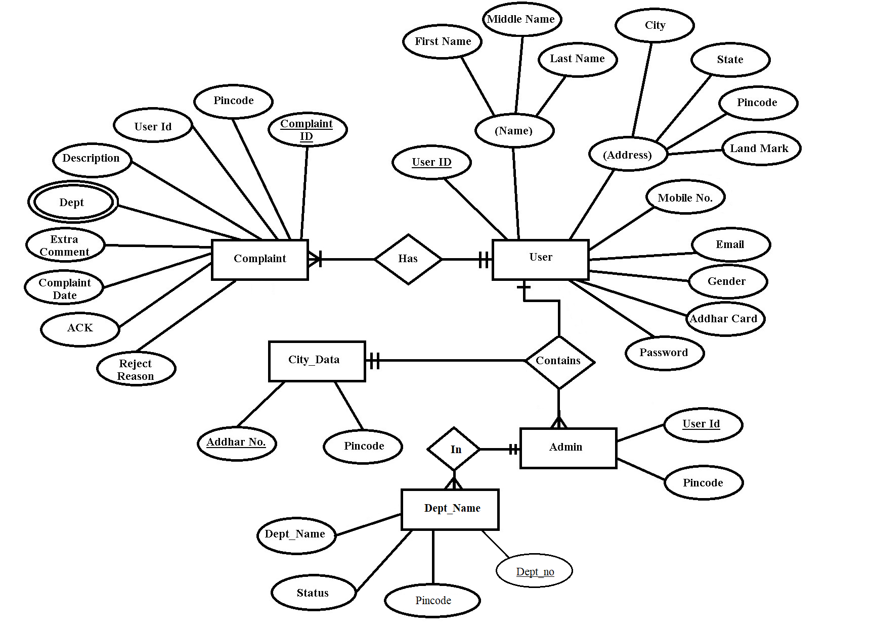
Proposed Approach

Slide 9
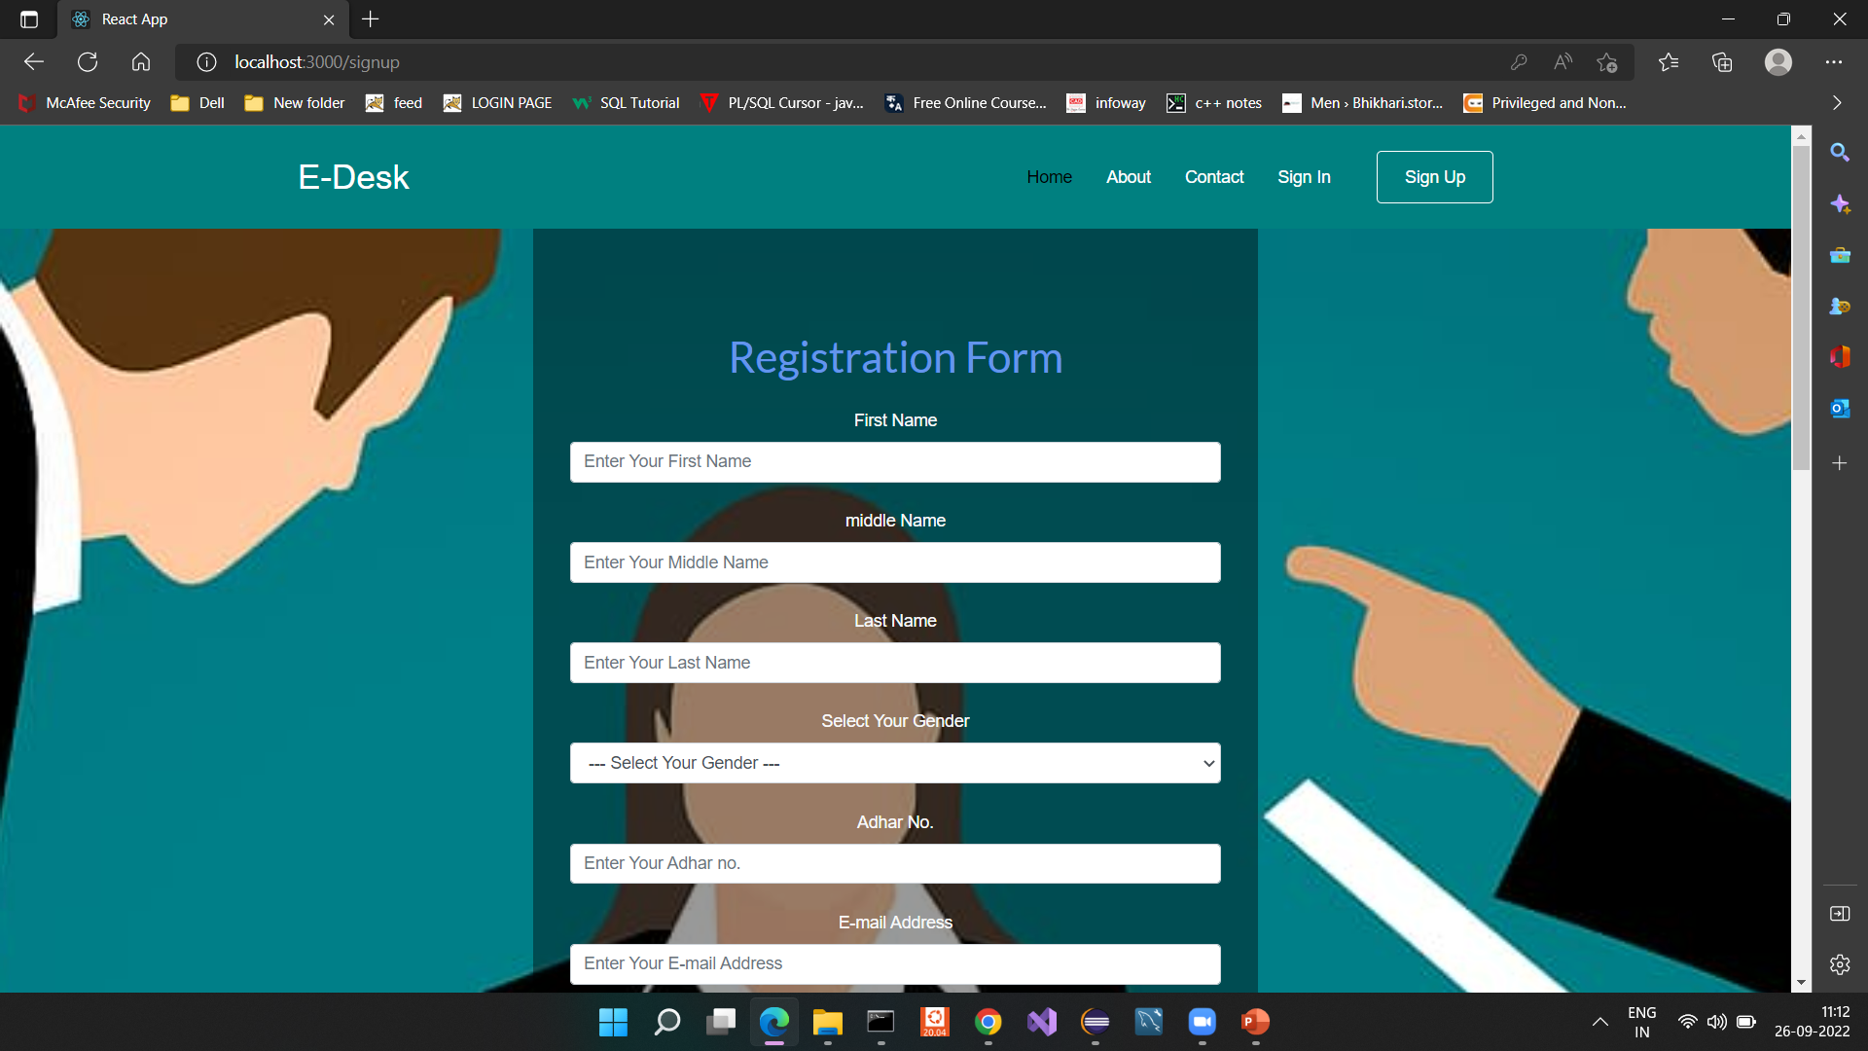
Screenshots

Slide 10
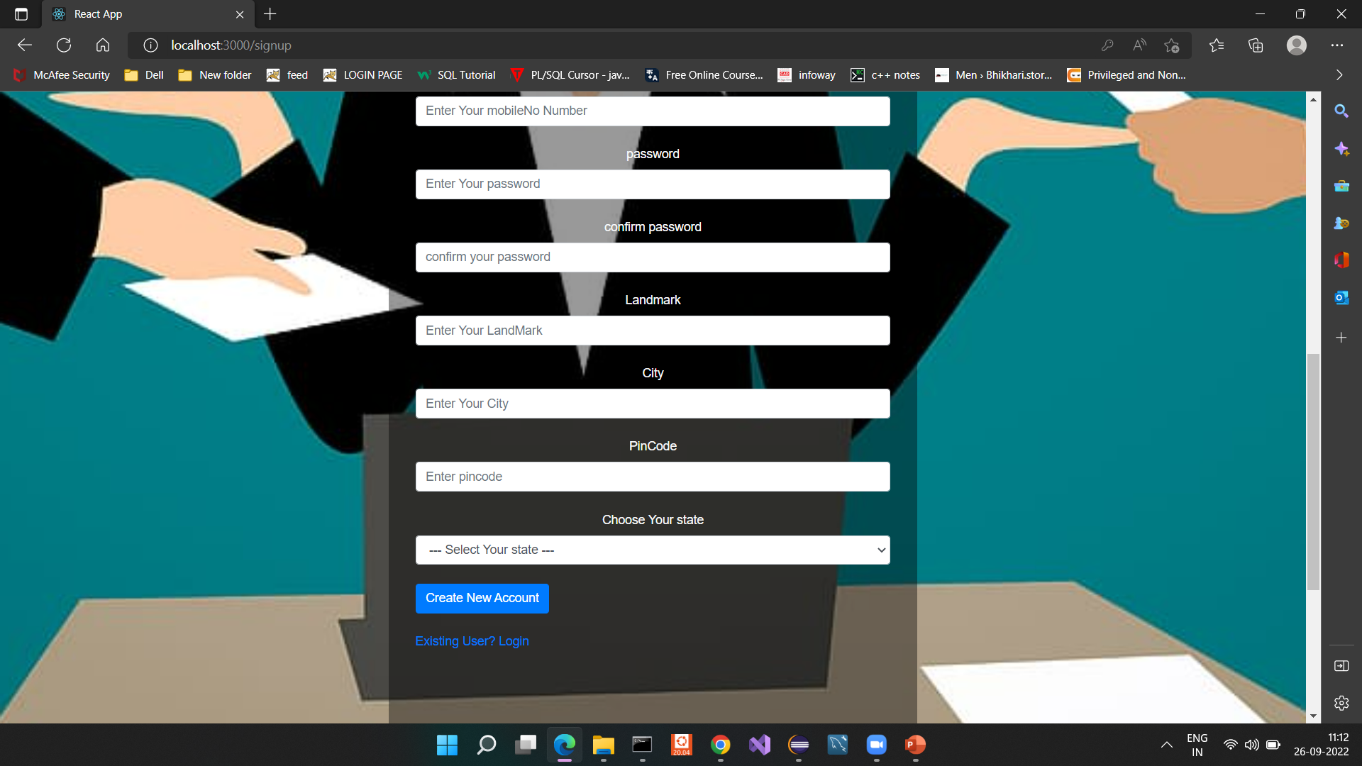

Slide 11
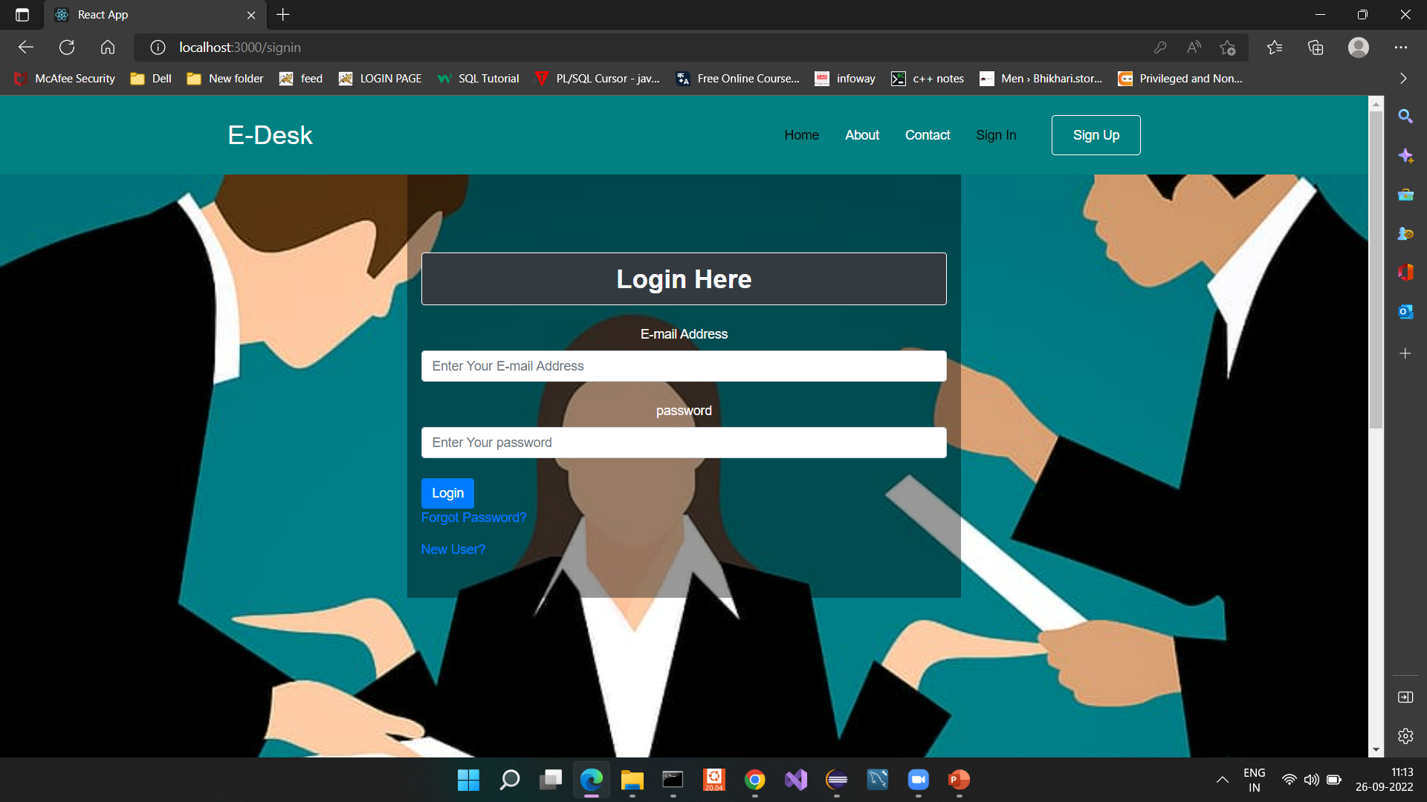

Slide 12
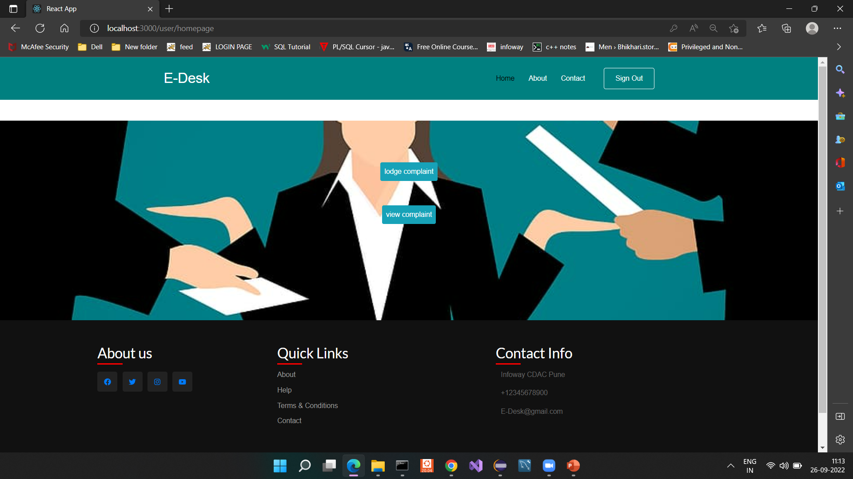

Slide 13
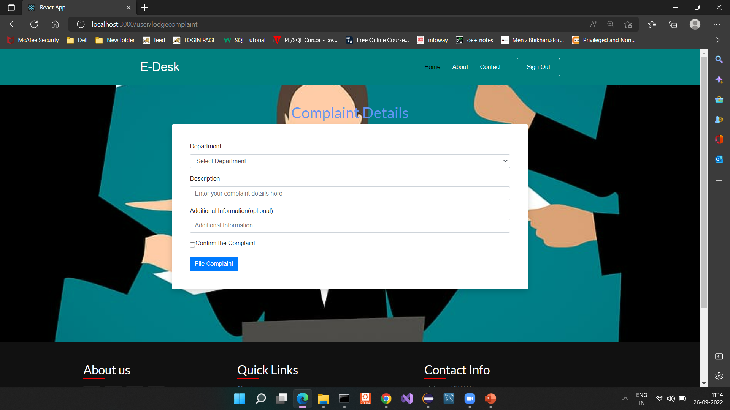

Slide 14
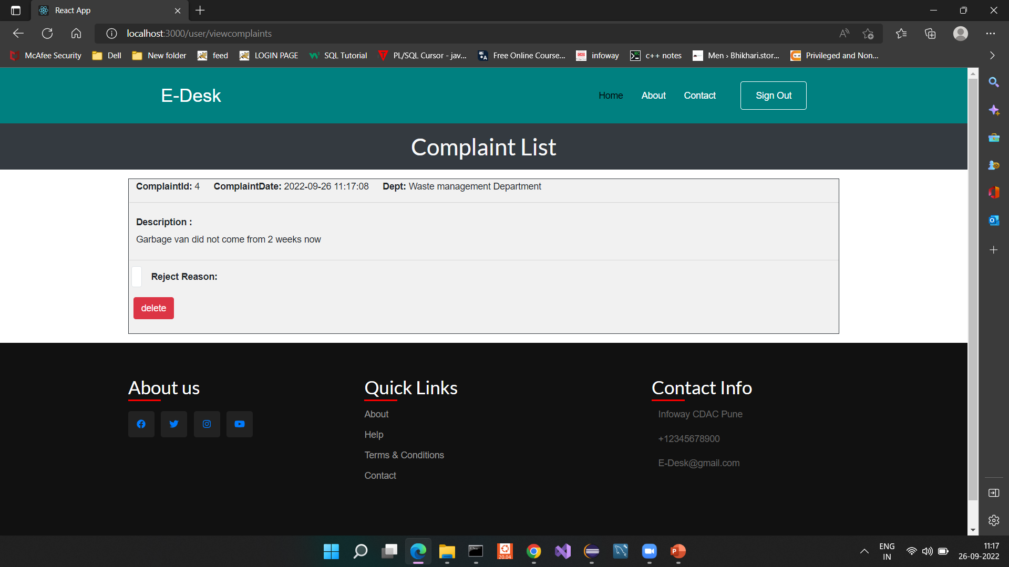

Slide 15
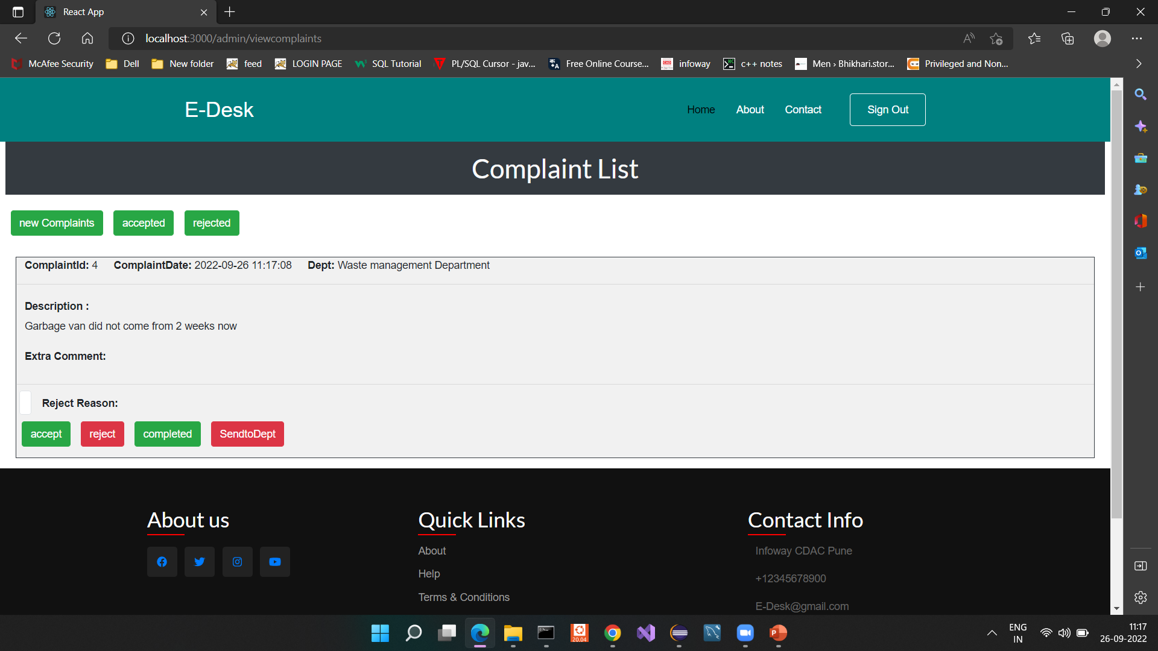

Slide 16
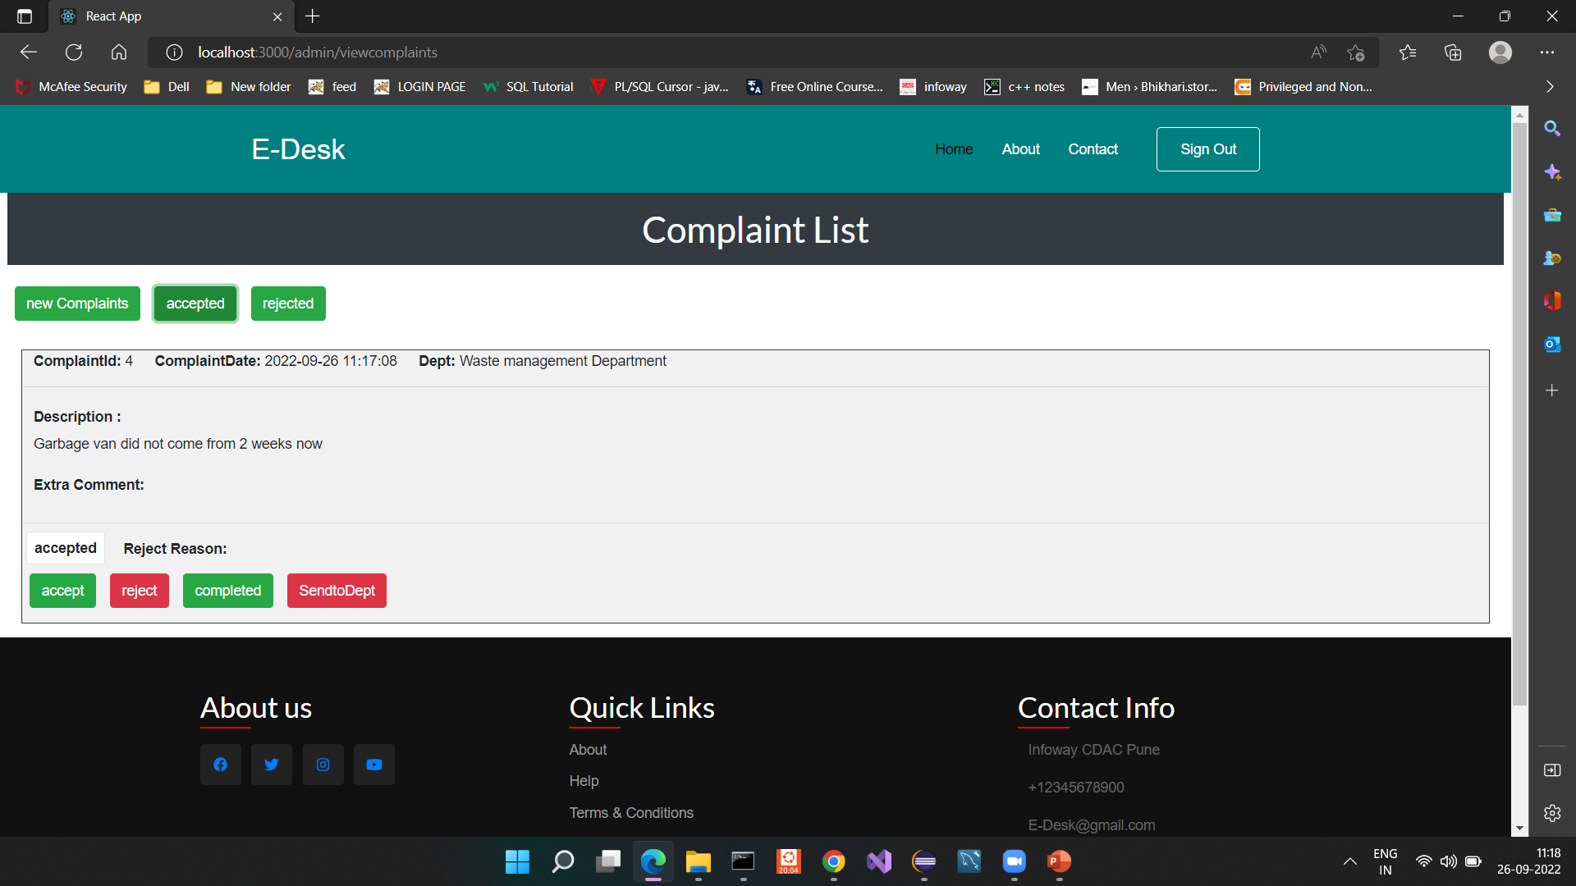

Slide 17


Slide 18


Slide 19
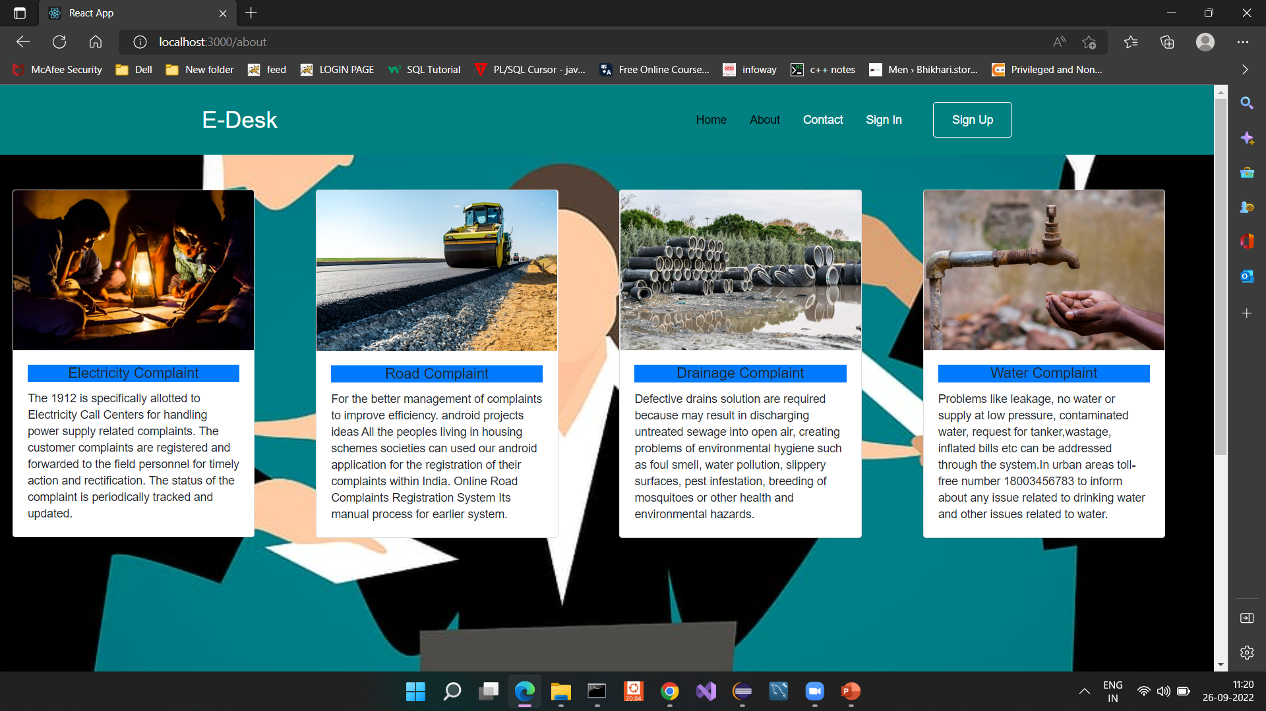

Slide 20
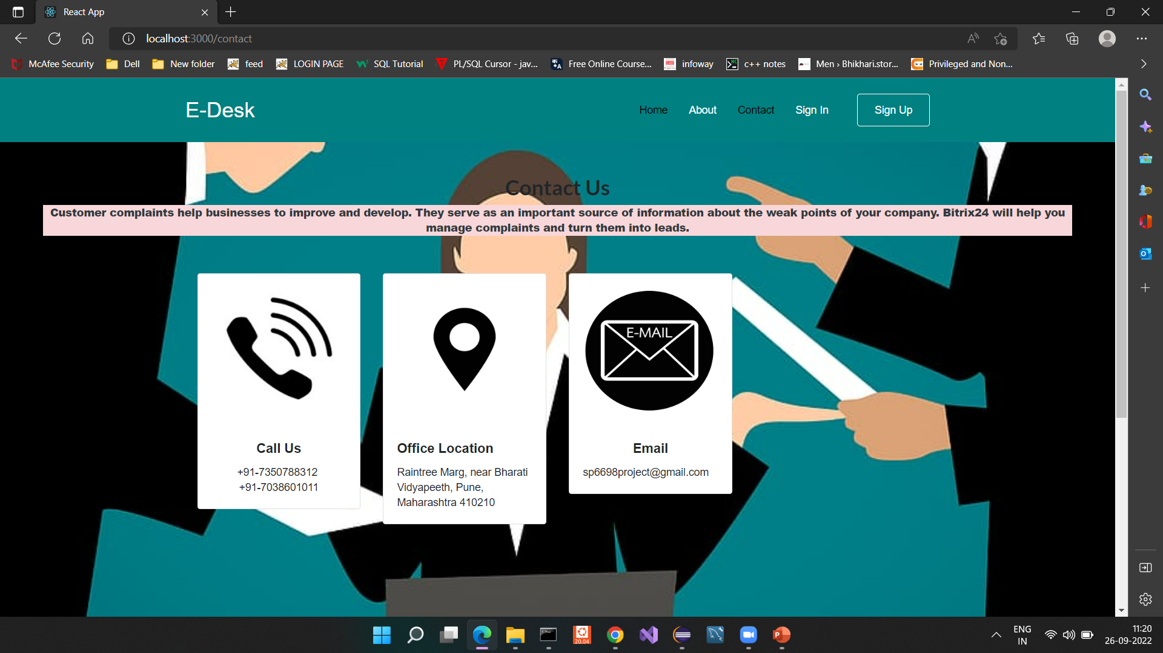

Slide 21
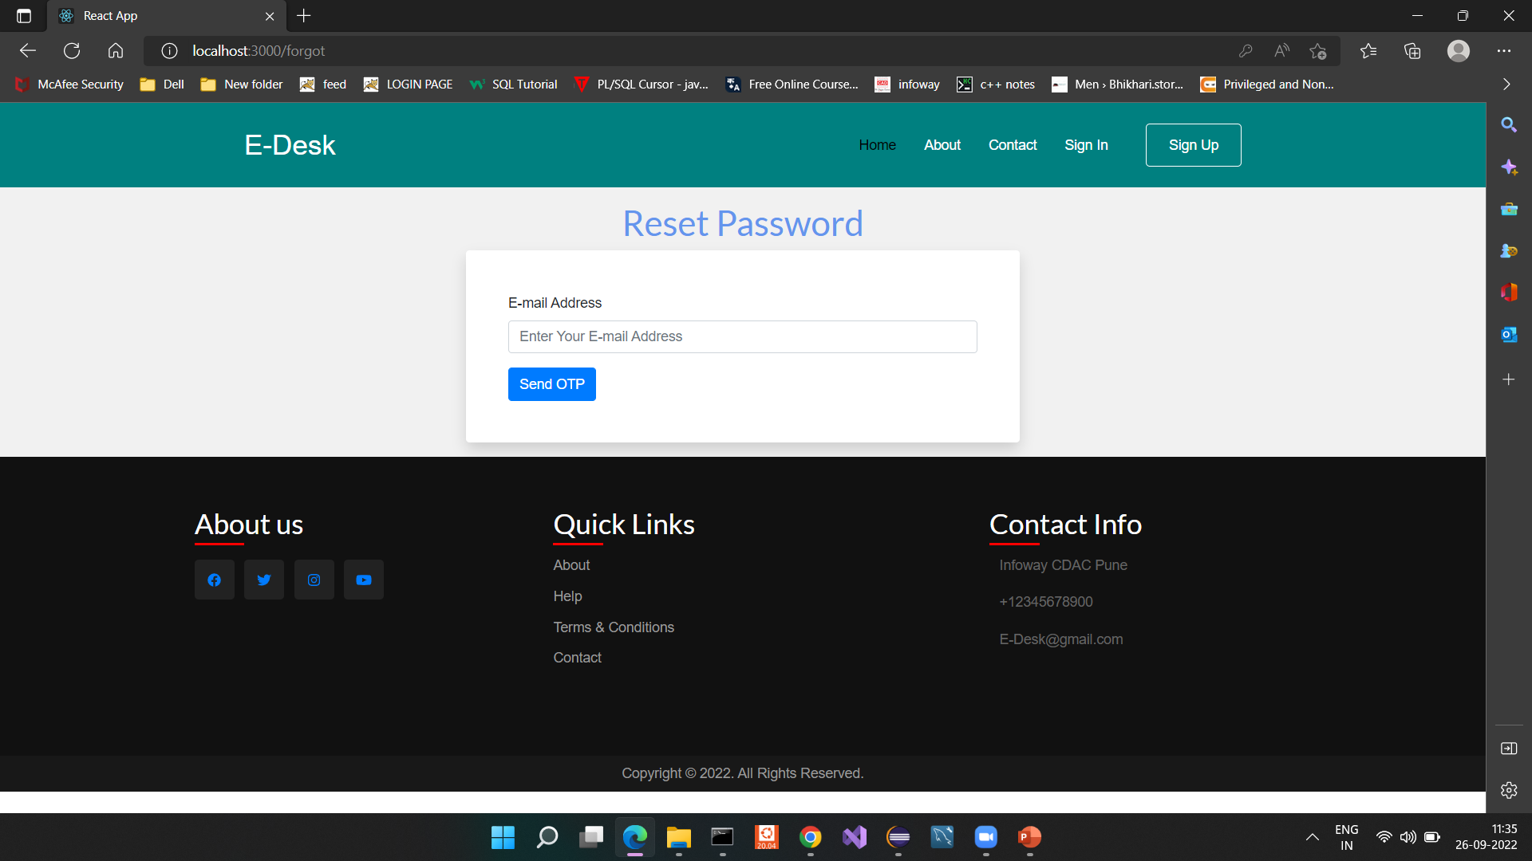

Slide 22
System Requirements
Software Requirements:
• Windows (All Versions)
• Tomcat 9
• Eclipse, MySQL
Hardware Components:
• Processor – i3
• Hard Disk – 5 GB
• Memory – 1GB RAM

Slide 23
Technologies Used
HTML : Page Layout has been designed in HTML.
CSS : Used for all designing part.
React Js : All Validation task and animations has been developed by React js .
JAVA : All the business logic has been written in JAVA EE(Spring boot).
MySQL : MySQL database has been used as database.
Tomcat : Project will run using Tomcat server.

Slide 24
Applications
Digitalize Municipal corporation.
Easy for the citizen to track the progress of its complaint.
Direct communication between the common man and the Municipal corporation.
Easy to Login & Fast complaint Processing .

Slide 25
Advantages
This application can help citizens to register their complaints easily and in a very short period of time.
It will reduce the time and effort for registering the complaint manually.
It is cost effective and user Friendly Tracking the progress of complaint would be easy.
They can get notifications of any new Notice.

Slide 26
Limitations
Required right E-mail Application to Track detailed.
It’s used only Mention (Aadhar card) city.
Here registration only based on Aadhar card.

Slide 27
Conclusion
This project provides a direct communication between the citizen and the municipal corporation. This will again help in registering the problems that one is facing in particular area and by continuously following up them will result in a good, clean and peaceful environment.
This project will save time and effort.

Slide 28
Future Scope
On Introduction of this Project will be able to give an opportunity to common man to make his environment better than today.In this manner the common people to deliver his complaints and problems to municipal authority as well as let the municipal authorities to address the issue as soon as possible.
If registration is done using Aadhar Card then registration can be done authentically and problems.

Slide 29
References
Mr. Saleel Bagde for Database.
Mrs. Harshita Maheshwari for HTML & React Js also she was our project guide.
Mrs. Mayuri mam for Java EE and Spring boot .
https://www.jetir.org/papers/JETIR2105037.pdf
https://www.irjet.net/archives/V7/i3/IRJET-V7I3861.pdf
B. Sudhir ,B. Regina, Sajidabhanu ‘Electronic Complaint Management System for Municipal Corporation’ in Communications onApplied Electronics (CAE) Foundation of Computer Science FCS, New York, USA Volume 2 – No.8, September 2015
V. SreeBhuvana, Y.Bhargavi, S.Rajasekhar, .MaheshBabu. ‗Online Municipal Complaints‘ (OMC) International Journal of Emerging Trends in Engineering Research, Vol.3.

Slide 30
Thank you!

